Slide 1
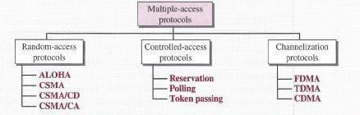
Multiple Acess Protocol's
If there is a dedicated link between the sender and the receiver then data link control layer is sufficient, however if there is no dedicated link present then multiple stations can access the channel simultaneously.
Hence multiple access protocols are required to decrease collision and avoid crosstalk.

Slide 2
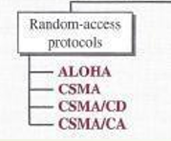
Random Access Protocol
In random-access or contention methods, no station is superior to another station and none is assigned control over another. At each instance, a station that has data to send uses a procedure defined by the protocol to make a decision on whether or not to send. This decision depends on the state of the medium (idle or busy).
There is no fixed time for sending data
There is no fixed sequence of stations sending data

Slide 3
1. ALOHA
Aloha is a Random access Protocol, It was actually designed for Wireless lan but it is also applicable for Shared Medium. It this Multiple Stations can transmit data at the same time And hence lead to collision and data being damaged.
Two Types
1. Pure Aloha
2. Slotted Aloha

Slide 4
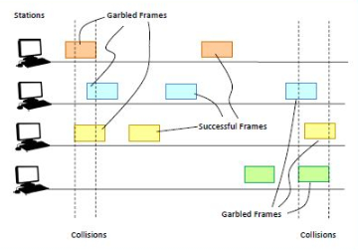
Pure Aloha
In pure ALOHA, the time of transmission is continuous. Whenever a station has an available frame, it sends the frame. If there is collision and the frame is destroyed, the sender waits for a random amount of time before retransmitting it.
Working Principle:
After transmitting a frame, a station waits for a finite period of time to receive an acknowledgement. If the acknowledgement is not received within this time, the station assumes that the frame has been destroyed due to collision and resends the frame.

Slide 5
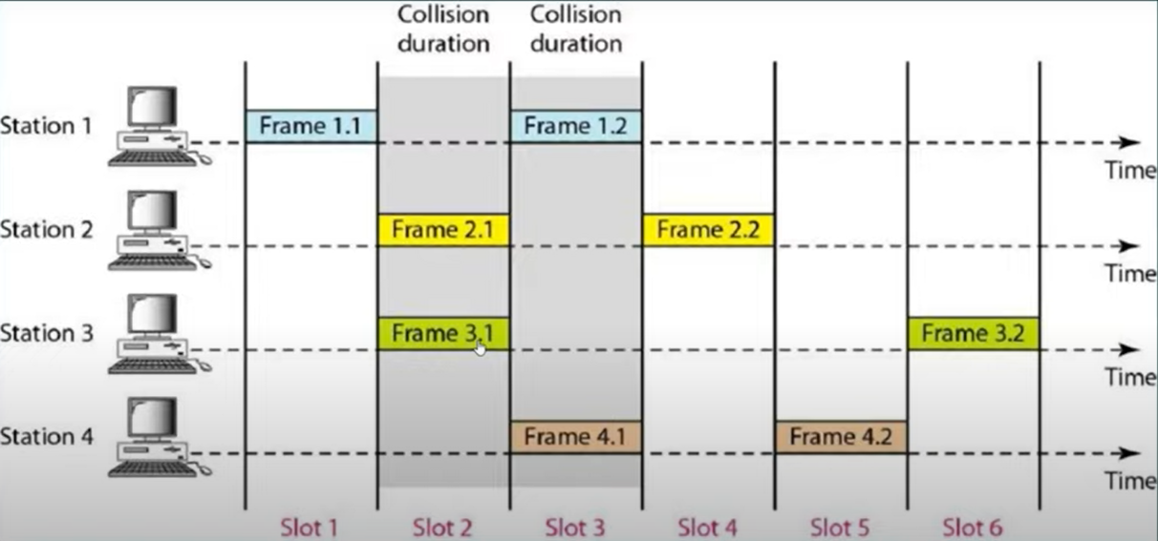
Slotted Aloha
It was Developed Just to improve the efficiency of pure aloha as the chances for collision in pure aloha are high
In slotted Aloha, the shared channel is divided into a fixed time interval called slots. So that, if a station wants to send a frame to a shared channel, the frame can only be sent at the beginning of the slot, and only one frame is allowed to be sent to each slot. If the station is failed to send the data, it has to wait until the next slot.

Slide 6
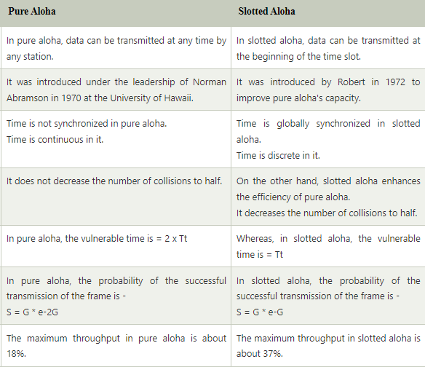
Difference Between Pure Aloha and Slotted Aloha

Slide 7
CSMA (Carrier Sense Multiple Access)
It is a carrier sense multiple access based on media access protocol to sense the traffic on a channel (idle or busy) before transmitting the data. It means that if the channel is idle, the station can send data to the channel. Otherwise, it must wait until the channel becomes idle. Hence, it reduces the chances of a collision on a transmission medium.
Types of CSMA
1-Persistent
P-Persistent
Non-Persistent

Slide 8
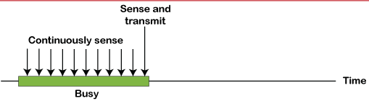
1-Persistent
Before Sending the data the station First Listen to the Channel to any one else is transmitting the data at the moment
If the Channel idle, the Station transmit Frame.
If Busy, then it sense the transmission medium Continuously until it became idle.
Since the channel transit's the frame with probability of 1 When the carrier is idle scheme of csma is called as Persistent Csma.

Slide 9
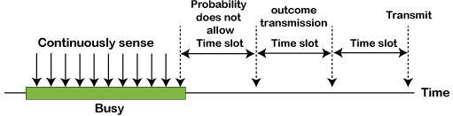
P-Persistent
It is the combination of 1-Persistent and Non-persistent modes.
It Applies to slotted channel,when a station becomes ready to send, it sense the Channel.
If it is idle, it transmit with probability p.
With a probability q=1-p, defer until for Next slot.
If the station initially sense the channel busy,it wait until next slot & Apply Algorithm

Slide 10
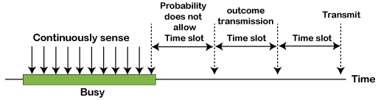
Non-Persistent
It is the access mode of CSMA that defines before transmitting the data, each node must sense the channel, and if the channel is inactive, it immediately sends the data. Otherwise, the station must wait for a random time (not continuously), and when the channel is found to be idle, it transmits the frames.

